Slide 1
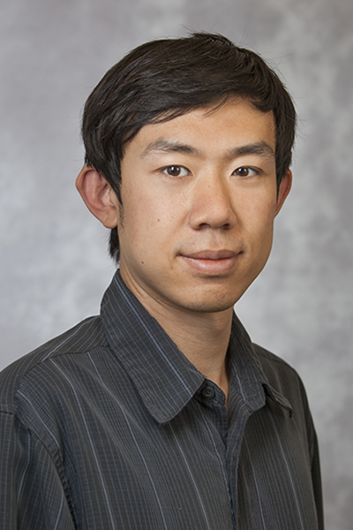
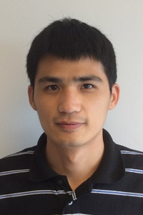
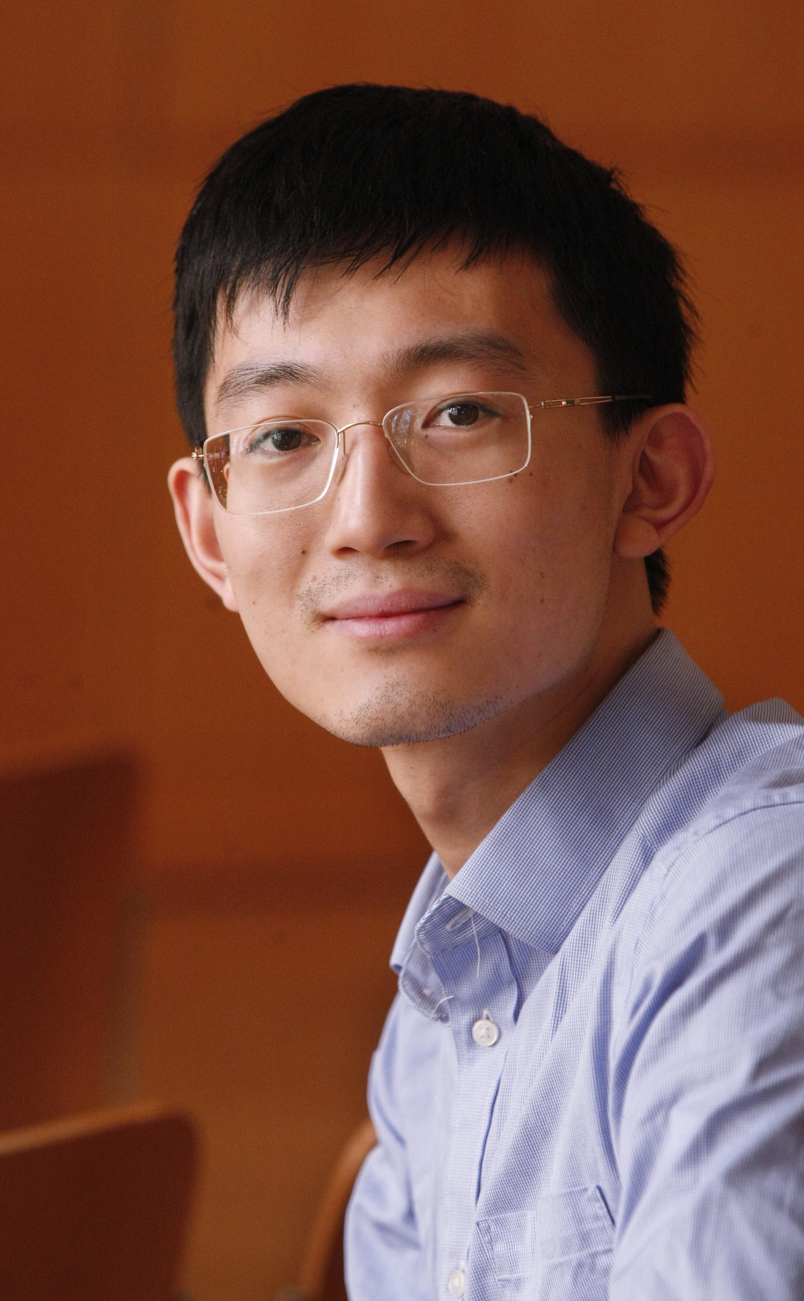
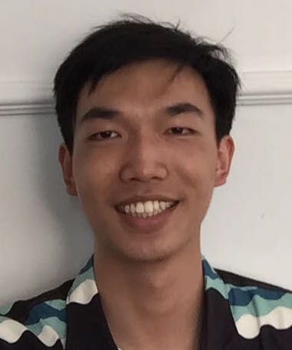
Generalization and Equilbrium in Generative Adversarial Nets (GANs)
Research seminar, Google March 2017
Sanjeev Arora
Princeton University (visiting Simons Berkeley)
Rong Ge Yingyu Liang Tengyu Ma Yi Zhang
(Funding: NSF, Simons Foundation, ONR)

Slide 2
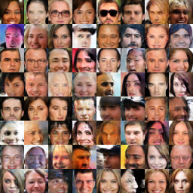
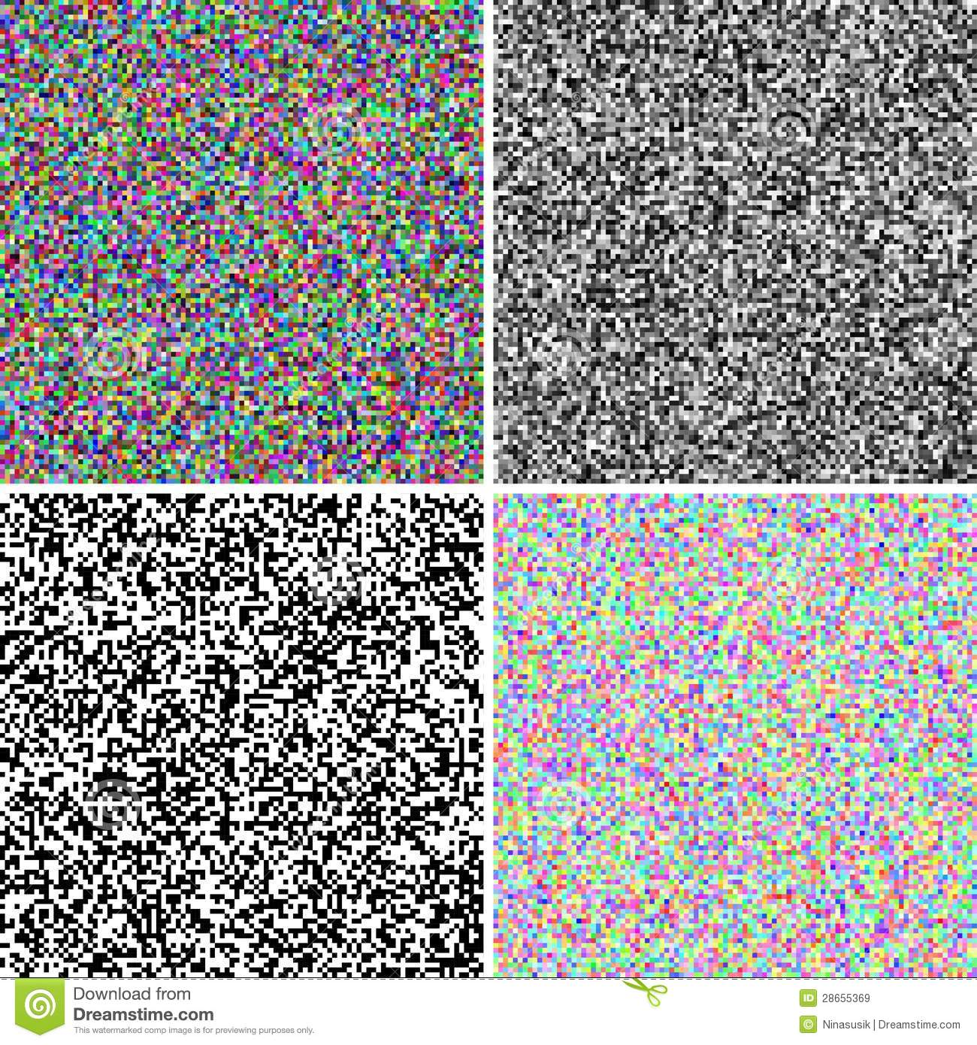
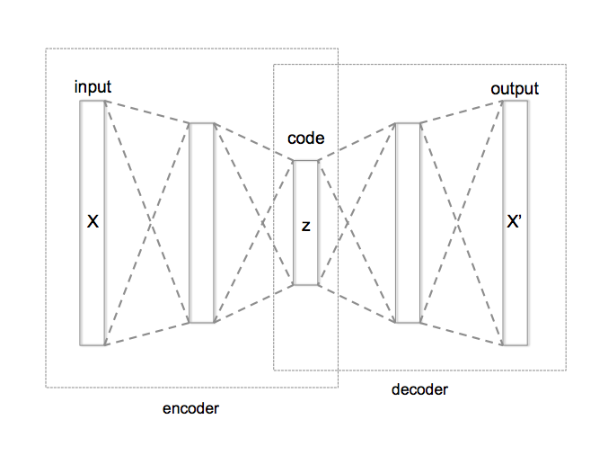
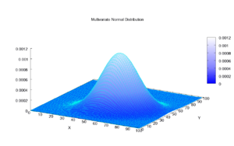
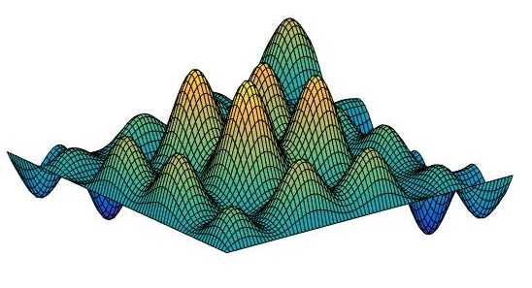
Deep generative models
Generative Model
N(O, I)
Denoising Auto encoders (Vincent et al’08)
Variational Autoencoder (Kingma-Welling’14)
GANs (Goodfellow et al’14)
Data Distribution
D_{real}

Slide 3
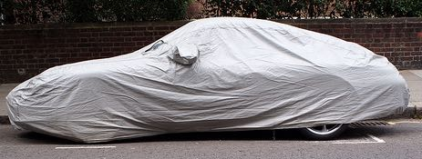
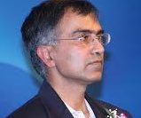
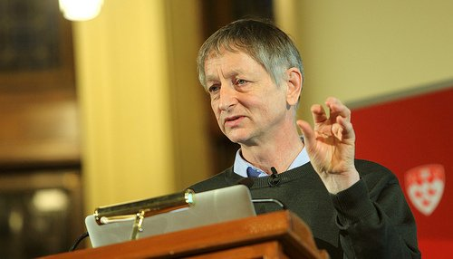
Prologue (2013, Place: Googleplex)
Why do you think realistic distributions are expressible by a small, shallow deep net?
Neural nets are like a universal basis that can approximate almost anything very efficiently
Geoff’s “Neural net hypothesis”
D_{real}

Slide 4
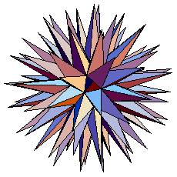
Geoff’s hypothesis is inconsistent with the curse of dimensionality
In d dimensions, there
are exp(d) directions whose pairwise angle is > 60 degrees
Real life
Distributions must be special in some way….
➔ # of distinct distributions > exp(exp(d)) (discretizing …..)
Counting argument shows we will need neural nets of size exp(d) to represent some of these distributions. (Recall: d = 10⁴ or more!)

Slide 5
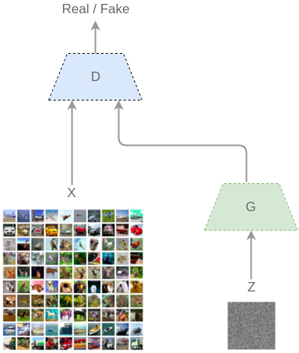
Generative Adversarial Nets (GANs) [Goodfellow et al. 2014]
Real (1) or Fake (0)
D_{v}
Discriminator doing its best to output 1 on real inputs, and 0 on synthetic inputs.
Generator doing its best to make synthetic inputs look like real inputs to discriminator.
D_{synth}
D_{real}
G_{u}
h
u= trainable parameters of Generator net
v = trainable parameters of Discriminator net
[Excellent resource: [Goodfellow’s survey]

Slide 6
Generative Adversarial Nets (GANs) [Goodfellow et al. 2014]
Wasserstein GAN
[Arjovsky et al’17]
Real (1) or Fake (0)
D_{v}
Discriminator doing its best to output 1 on real inputs, and 0 on synthetic inputs.
Generator doing its best to make synthetic inputs look like real inputs to discriminator.
D_{synth}
D_{real}
G_{u}
h
u= trainable parameters of Generator net
v = trainable parameters of Discriminator net

Slide 7
Generative Adversarial Nets (GANs)
Real (1) or Fake (0)
D_{v}
Repeat until convergence….
D_{synth}
Backprop update on discriminator that nudges it towards saying 1 more on real inputs and saying 0 more on synthetic inputs.
Backprop update on generator that make it more like to produce synthetic inputs that make discriminator more likely to output 1.
D_{real}
G_{u}
h
Frequent problem: instability (oscillation in the above value)
u= trainable parameters of Generator net
v = trainable parameters of Discriminator net

Slide 8
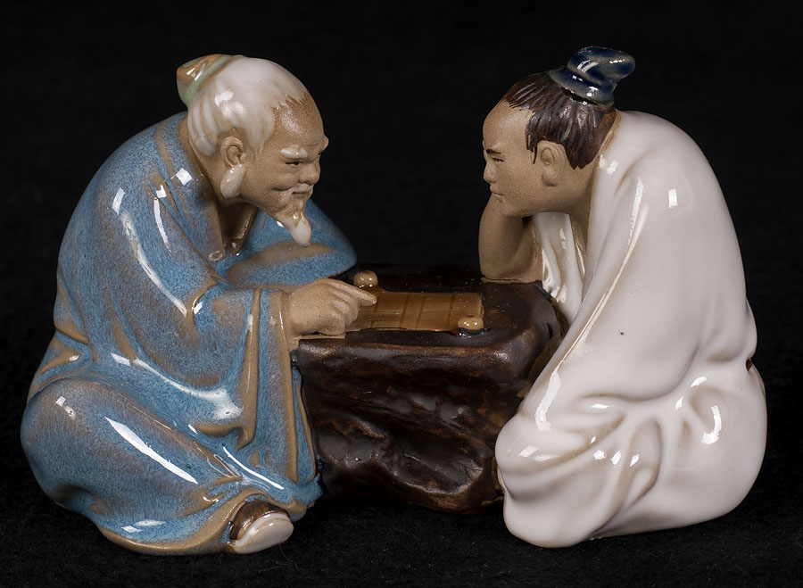
GANs as 2-player games
Real (1) or Fake (0)
D_{v}
The “moves”
Payoff from generator to discriminator
D_{real}
D_{synth}
G_{u}
Necessary stopping
condition: equilibrium (“payoff unchanged if we flip the order of moves”)
h
u= trainable parameters of Generator net
v = trainable parameters of Discriminator net

Slide 9
Issues addressed in this talk
Generalization. Suppose generator has ”won” at the end on the empirical samples (i.e. discriminator has been left with no option but random guessing). Does this mean in any sense that the true distribution has been learnt?
Past analyses: If discriminator capacity and # samples are “very large”, then yes since Wasserstein distance is exactly
D_{real} ≈
D_{synth} ??
Equilibrium. Does an equilibrium exist in this 2-person game? (a priori, pure equilibrium not guaranteed; think rock/paper/scissors)
(Also, insight into Geoff’s hypothesis….)

Slide 10
Bad news: Bounded capacity discriminators are weak
Theorem: If discriminator has capacity n its distinguishing probability between these two distributions is < ε .
(Proof: Standard Epsilon-net argument; coming up)
Notes: (i) Still holds if many more samples available from D_{real} , including any number of held-out samples.
(ii) Suggests current GAN objectives may be unable to enforce sufficient diversity in generator’s distribution.
Uniform distribution on
(nlog n)/ε² random samples from D_{real}
D_{real}

Slide 11

Aside: Proposed defn of Generalization
The learning generalizes if the following two track each other closely:
Objective value on empirical distribution on samples from D_{synth} and D_{real}
and
distance between the full distributions D_{synth} and D_{real}
Theorem: Generalization does not happen for the usual distances such as Jensen-Shannon (JS) divergence, Wasserstein, and l₁.
Is there any distance for which generalization happens?

Slide 12
(Partial good news): If # of samples > (nlog n)/ε² then performance on the samples tracks (within ε) the performance on the full distribution.
(Thus, “generalization” does happen with
respect to “neural net distance”.)
(Similar theorems proved before in pseudorandomness [Trevisan et al’08], statistics [Gretton et al’12].)

Slide 13
Generalization happens for NN distance
Idea 1: Deep nets are “Lipschitz” with respect to their trainable parameters. (Changing parameters by δ changes the deep net’s output by < C δ for some small C.)
Idea 2: If # of parameters = n, there are only exp(n/ε) fundamentally distinct deep nets (all others are ε-“close” to one of these…) (“epsilon-net”)
Idea 3: For any fixed discriminator D, once we draw > nlog n/ε² samples
from D_{real} and D_{synth} then probability is at most exp(-n/ε) that its distinguishing ability on these samples is not within ±ε of its distinguishing ability for full distrib.
“Epsilon-net argument”
Idea 2 + Idea 3 + Union bound => The empirical NN distance on nlog n/ε² samples
tracks the overall NN distance.

Slide 14

What have we just learnt?
Suppose generator just won.. (i.e. discriminator’s distinguishing probability close to 0)
If the number of samples was somewhat more than # of trainable parameters of the discriminator, and the discriminator played optimally on this empirical sample…
Then generator would win against all discriminators on the full distribution.
But why should the generator win in the first place??

Slide 15
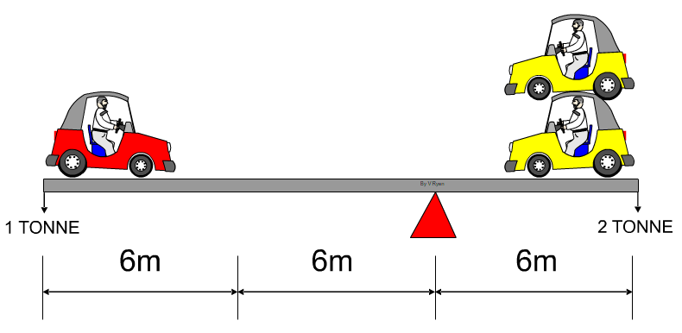
Equilibrium in GAN game
Payoff =
(defined analogously for other measuring functions too….)
Equilibrium: Discriminator D and generator G s.t.:
D gets max payoff from G among all discriminators in its class,
G ensures min payoff to D among all generators in its class
“PURE” Equilibrium; may not exist (e.g., rock/paper/scissor)
We’re hoping for equilibrium to exist, and moreover, one where Payoff =0 (“Generator Wins”)

Slide 16
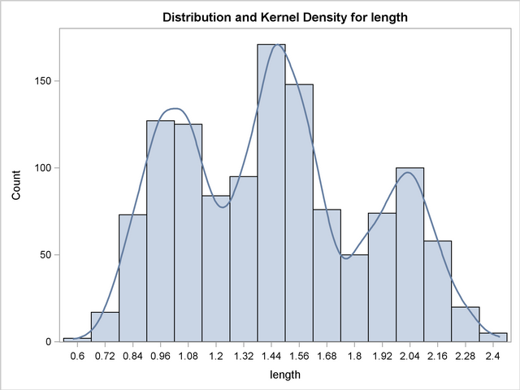
Thought experiment
Instead of single generator net, what if we allow an infinite mixture of generator nets?
Fact: These can represent D_{real} quite closely (e.g., Kernel Density Estimation)
What about finite mixtures of generator nets??
Theorem: A mixture of nlog n/ε² generator nets can produce
a distribution D_{synth} that looks like* D_{real} to every deep net discriminator with n trainable parameters (*distinguishing probability < ε).
Proof: Epsilon net argument. There are only exp(n/ε) “different” deep nets.

Slide 17

Existence of an equilibrium
Argument works for other measuring functions too
Payoff =
Equilibrium: Discriminator D and generator G s.t.:
D gets max payoff from G among all discriminators in its class,
G ensures min payoff to D among all generators in its class
[von Neumann Min-Max Theorem] There exists an equilibrium if replace“Discriminator” by “Infinite mixture of Discriminators” and “Generator” by “Infinite mixture of Generators.”
By our recent observation, in such an equilibrium for the GAN game, generator “wins” (i.e Payoff = 0)

Slide 18
Existence of approximate equilibrium
Equilibrium: Discriminator D and generator G s.t.:
D gets max payoff from G among all discriminators in its class, >= V - ε
G ensures min payoff to D among all generators in its class <= V + ε
ε-approximate
V = payoff in von Neumann’s equilibrium
Claim: If discriminator and generator are deep nets with n trainable variables,
then there exists an ε-approximate equilibrium when we allow mixtures of size nlog n/ε². (Proof: Epsilon net argument)

Slide 19
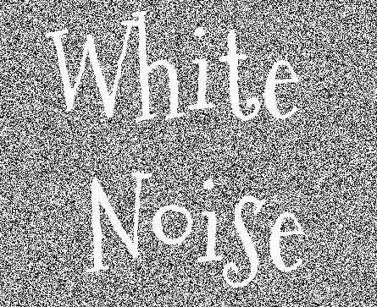
Existence of approximate pure equilibrium (proof only works for Wasserstein objective)
Take the “small mixture” approximate equilibrium of previous slide, and show that the small mixture of deep nets can be simulated by a single deep net.
W₁
W₂
W₃
W₂
G₁
G₂
G₃
W₁
W₃
G₁
G₂
G₃
Selector circuit

Slide 20
Empirics: MIX + GAN protocol
W₁
W₂
W₃
G₁
G₂
G₃
Can be used to enhance GAN game for any existing architecture Player 1= mixture of k discriminators Player 2 = mixture of k generators. ( k = max that fits in GPU; usually k =3 to 5)
Maintain separate weight for each component of mixture; update via backpropagation
Use entropy regularizer on weights (discourages mixture from collapsing; has some theoretical justification)

Slide 21
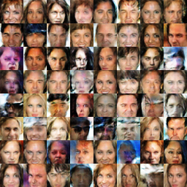
DC-GAN improved version (Huang et al’16)
vs MIX + DC-GAN (3 components in mixture)
Trained on CeleA Faces Dataset (Liu et al 2015)

Slide 22
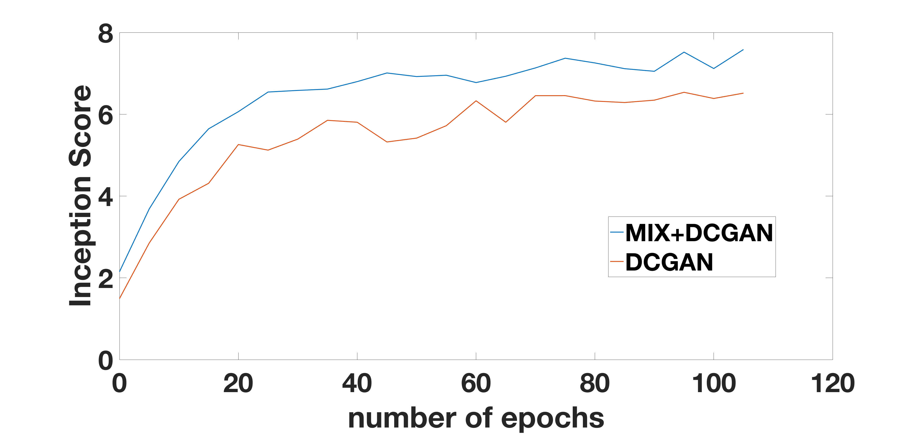
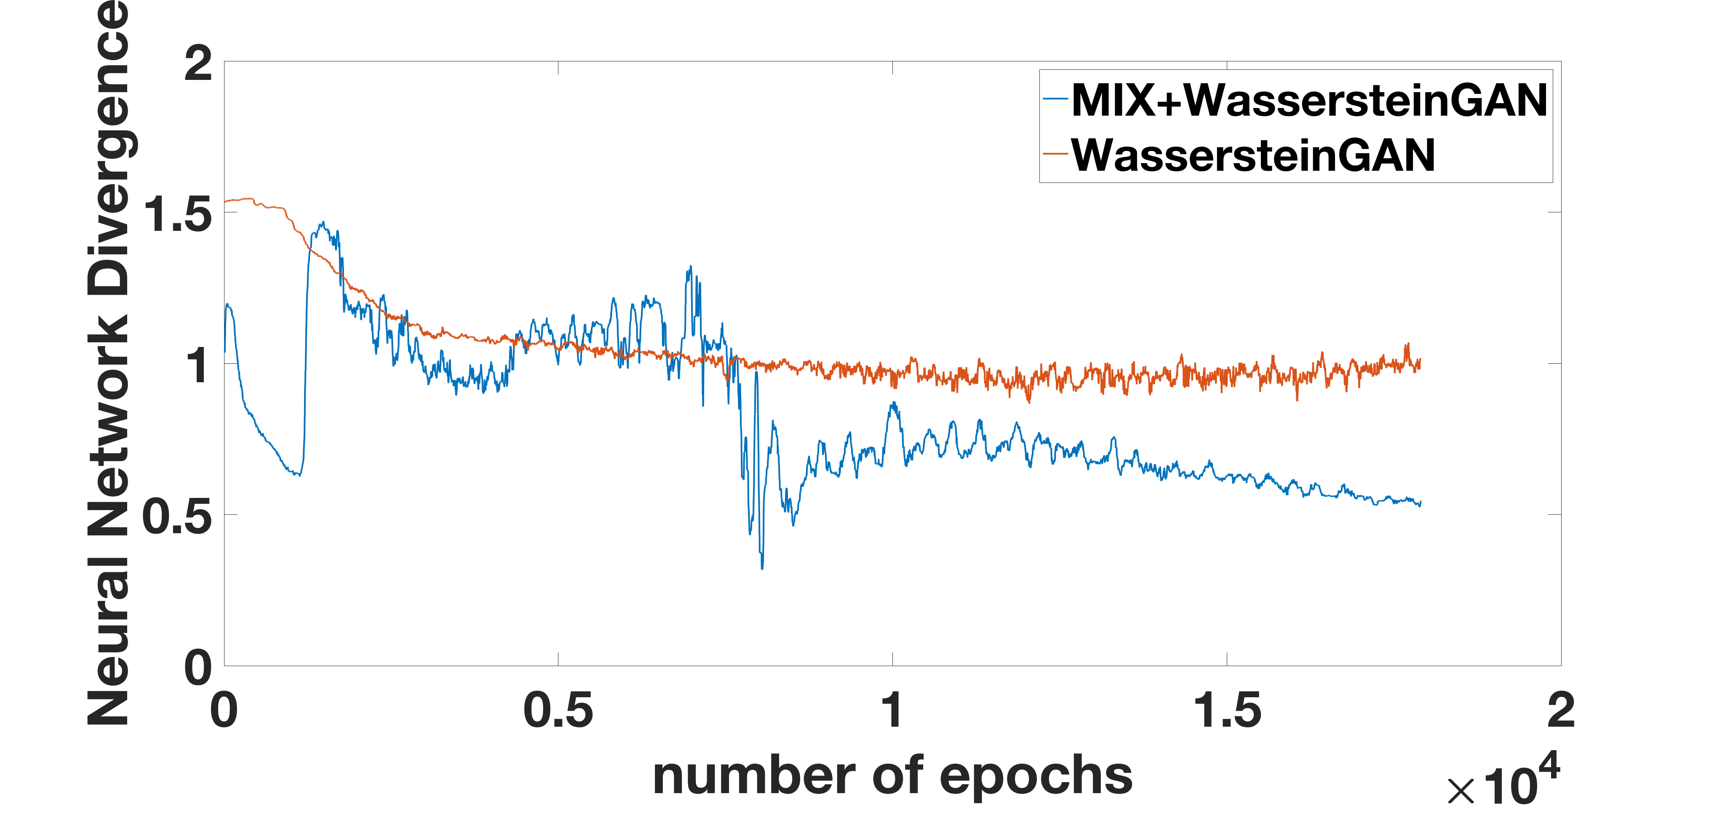
Quantitative comparison
Inception Score due to (Salimans et al 2016);
Higher is better
Wasserstein Loss (proposed in Arjovsky et al 2017; claimed to correlate better with image quality)

Slide 23
Takeaway lessons
(BLOG WRITEUP AT: www.offconvex.org “Off the Convex Path.”)
Focused on generalization and equilibrium in GANs. No insight into what actually may happen with backpropagation…
We’re measuring performance using objective function. Some evidence (in case of supervised training) that backprop can improve performance without this showing up in the training objective.
With above caveats, GANs objective doesn’t appear to enforce diversity in the learnt distribution.
Analysis highlights that if GANs work, this is because of some careful interplay between discriminator capacity, generator capacity, and training algorithm. This was hidden by earlier analyses involving infinite discriminator and training data.
Open: sharper analysis. (Need to go beyond standard epsilon-net arguments.)

Slide 24
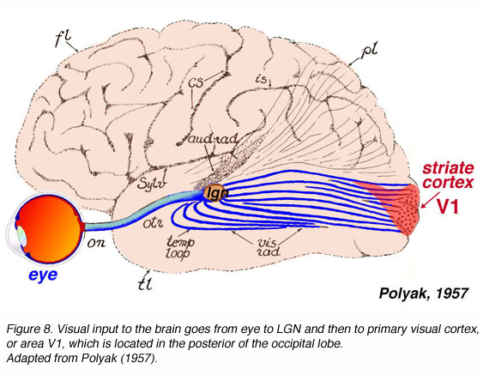
Epilogue: Recall mystery of Geoff’s “Neural Net Hypothesis”
A resolution??
D_{real} = Infinite mix of v. simple generators (classical statistics)
Reasonable size generators can produce distribution D_{synth} that is indistinguishable from D_{real} by any small neural net.
D_{synth} should look like D_{real} to us if our visual system is a small neural net…
curse of dimensionality…
Real life
Distributions must be special in some way….

Slide 25
Postscript: Distributions learnt by current GANs indeed have low diversity.
Birthday paradox test (for lack of diversity)
Suppose some distribution is supported on N images.
Then there is a good chance that a sample of size √N has a duplicate image.
We find that GANs trained on CIFAR 10, Faces etc. the duplicate image
Happens for samples of size 500-600.
➔ Support is about 20-25K.

Slide 26
Stacked GAN on CIFAR-10
First two rows contain
Duplicate images in
Random sample
(Size 100 for truck; 200 for horse; 300 for dog)
Last row is closest image
in training set.
(Training set for each
Category has size 6k)

Slide 27
Duplicates on CelebA (faces) training
Duplicates found among 640 samples
(Training set has size 200k)

